Slide 1
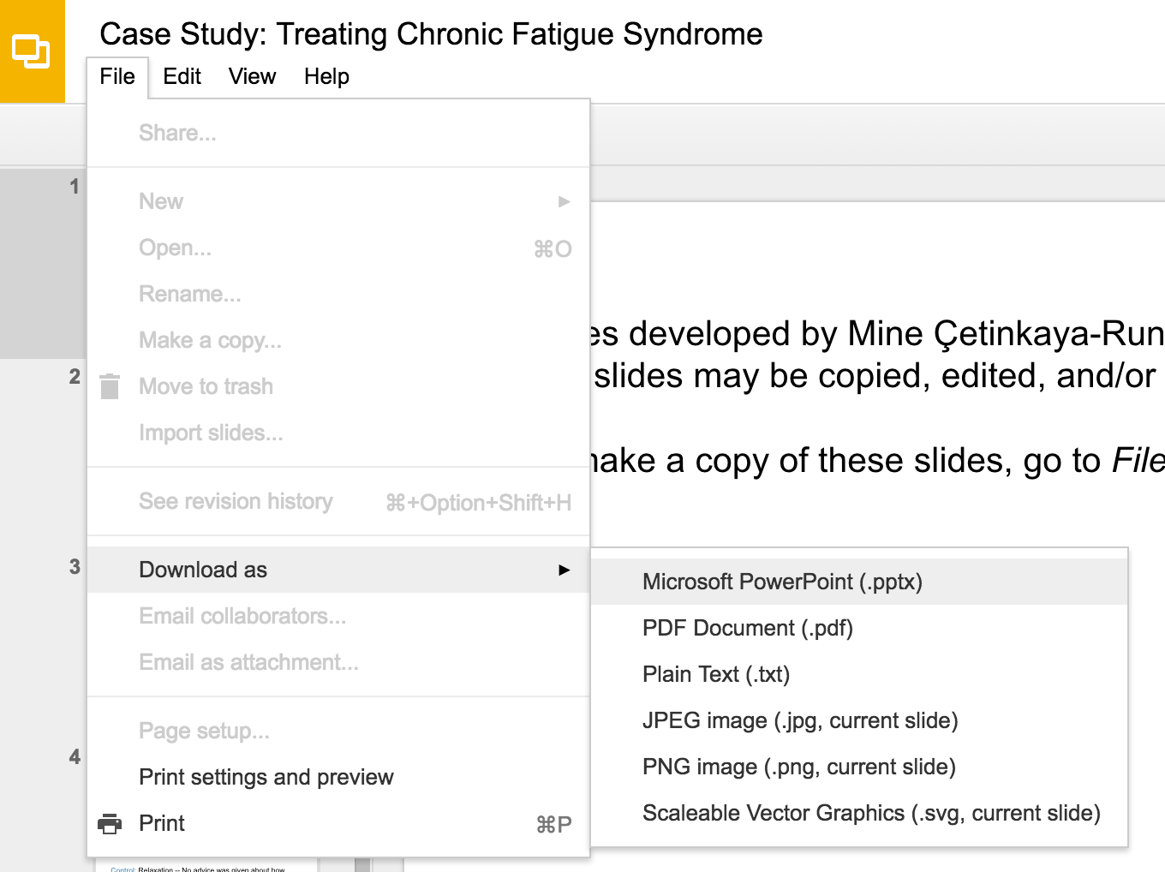
Slides developed by Mine Çetinkaya-Rundel of OpenIntro
Translated from LaTeX to Google Slides by Curry W. Hilton of OpenIntro.
The slides may be copied, edited, and/or shared via the CC BY-SA license
To make a copy of these slides, go to File > Download as > [option], as shown below. Or if you are logged into a Google account, you can choose Make a copy... to create your own version in Google Drive.

Slide 2
Logistic regression

Slide 3
Regression so far ...
At this point we have covered:
27

Slide 4
Regression so far ...
At this point we have covered:
Simple linear regression
Relationship between numerical response and a numerical or categorical predictor
27

Slide 5
Regression so far ...
At this point we have covered:
Simple linear regression
Relationship between numerical response and a numerical or categorical predictor
Multiple regression
Relationship between numerical response and multiple numerical and/or categorical predictors
27

Slide 6
Regression so far ...
At this point we have covered:
Simple linear regression
Relationship between numerical response and a numerical or categorical predictor
Multiple regression
Relationship between numerical response and multiple numerical and/or categorical predictors
What we haven’t seen is what to do when the predictors are weird (nonlinear, complicated dependence structure, etc.) or when the response is weird (categorical, count data, etc.)
27

Slide 7
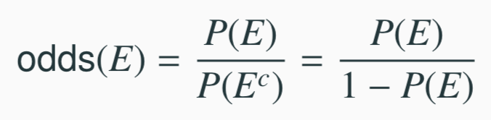
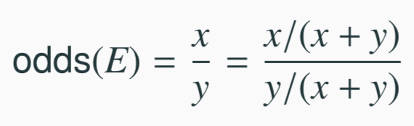
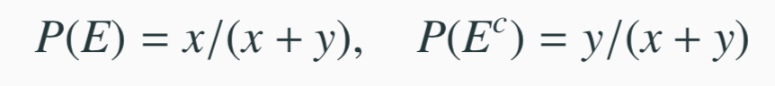
Odds
Odds are another way of quantifying the probability of an event, commonly used in gambling (and logistic regression).
For some event E,
Similarly, if we are told the odds of E are x to y then
which implies
27

Slide 8
Example - Donner Party
In 1846 the Donner and Reed families left Springfield, Illinois, for California by covered wagon. In July, the Donner Party, as it became known, reached Fort Bridger, Wyoming. There its leaders decided to attempt a new and untested rote to the Sacramento Valley. Having reached its full size of 87 people and 20 wagons, the party was delayed by a difficult crossing of the Wasatch Range and again in the crossing of the desert west of the Great Salt Lake. The group became stranded in the eastern Sierra Nevada mountains when the region was hit by heavy snows in late October. By the time the last survivor was rescued on April 21, 1847, 40 of the 87 members had died from famine and exposure to extreme cold.
From Ramsey, F.L. and Schafer, D.W. (2002). The Statistical Sleuth: A Course in Methods of Data Analysis (2nd ed)

Slide 9
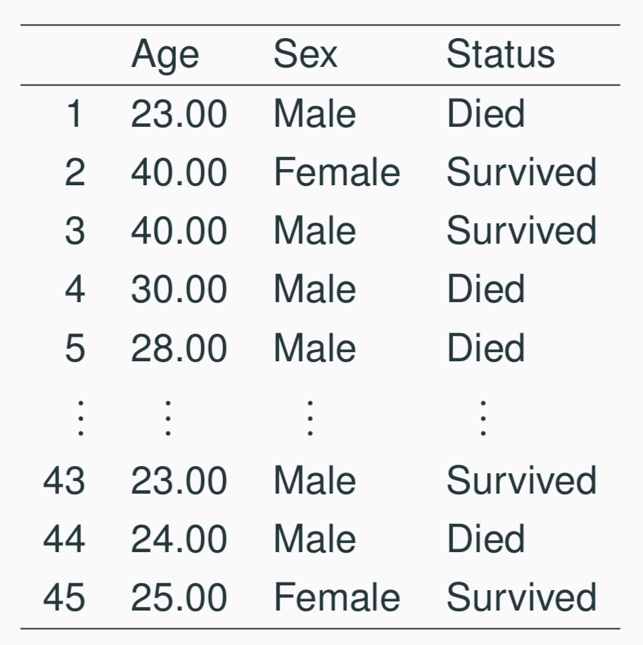
Example - Donner Party - Data
27

Slide 10
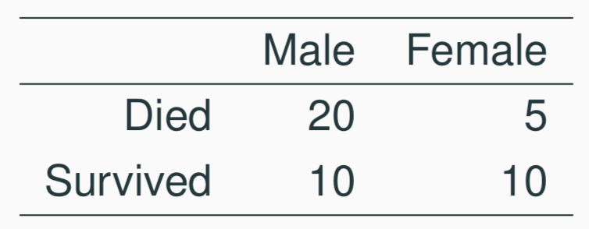
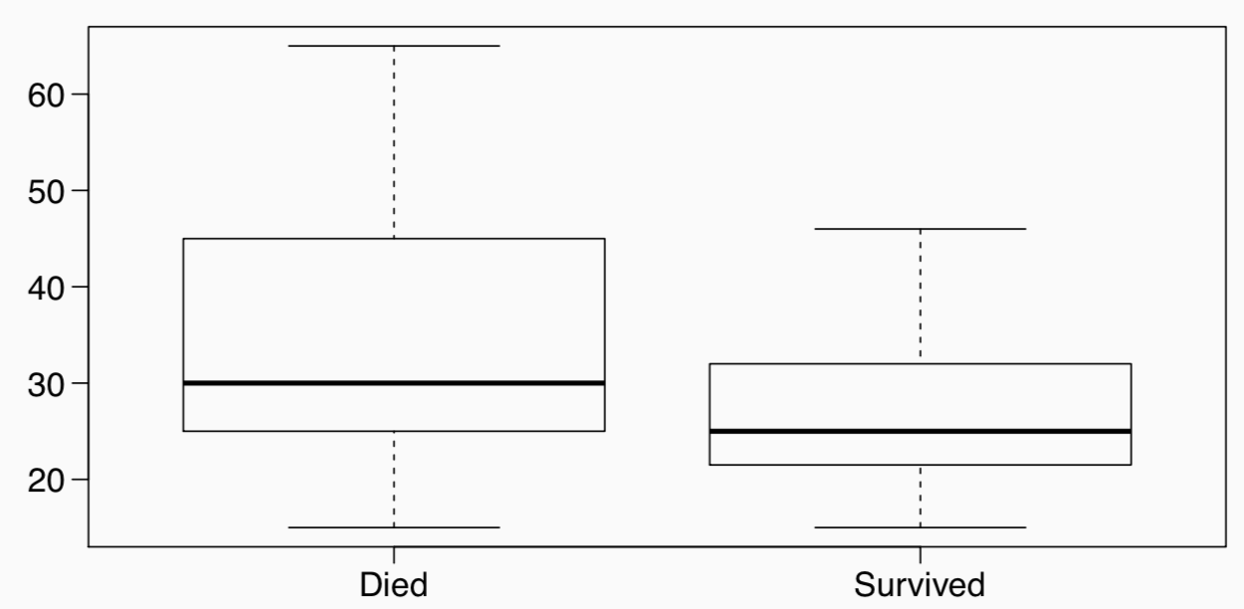
Example - Donner Party - EDA
Status vs Gender
Status vs Age
27

Slide 11
Example - Donner Party
It seems clear that both age and gender have an effect on someone’s survival, how do we come up with a model that will let us explore this relationship?
Even if we set Died to 0 and Survived to 1, this isn’t something we can transform our way out of - we need something more.
One way to think about the problem - we can treat Survived and Died as successes and failures arising from a binomial distribution where the probability of a success is given by a transformation of a linear model of the predictors.
27

Slide 12
Generalized linear models
It turns out that this is a very general way of addressing this type of problem in regression, and the resulting models are called generalized linear models (GLMs). Logistic regression is just one example of this type of model.
27

Slide 13
Generalized linear models
It turns out that this is a very general way of addressing this type of problem in regression, and the resulting models are called generalized linear models (GLMs). Logistic regression is just one example of this type of model.
All generalized linear models have the following three characteristics:
A probability distribution describing the outcome variable
A linear model: η = β₀ +β₁X₁ +···+β_{n}X_{n}.
A link function that relates the linear model to the parameter of the outcome distribution: g(p) = η or p = g⁻¹(η).
27

Slide 14
Logistic Regression
Logistic regression is a GLM used to model a binary categorical variable using numerical and categorical predictors.
We assume a binomial distribution produced the outcome variable and we therefore want to model p the probability of success for a given set of predictors.
27

Slide 15
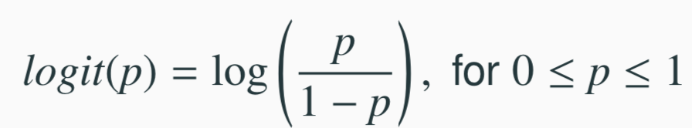
Logistic Regression
Logistic regression is a GLM used to model a binary categorical variable using numerical and categorical predictors.
We assume a binomial distribution produced the outcome variable and we therefore want to model p the probability of success for a given set of predictors.
To finish specifying the Logistic model we just need to establish a reasonable link function that connects η to p. There are a variety of options but the most commonly used is the logit function.
Logit function
27

Slide 16
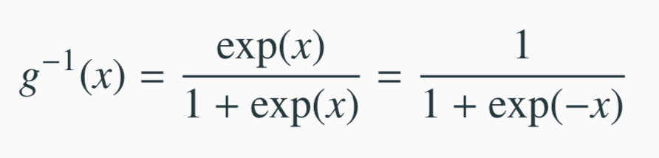
Properties of the Logit
The logit function takes a value between 0 and 1 and maps it to a value between −∞ and ∞.
Inverse logit (logistic) function
The inverse logit function takes a value between −∞ and ∞ and maps it to a value between 0 and 1.
This formulation also has some use when it comes to interpreting
the model as logit can be interpreted as the log odds of a success,
68 more on this later.
27

Slide 17
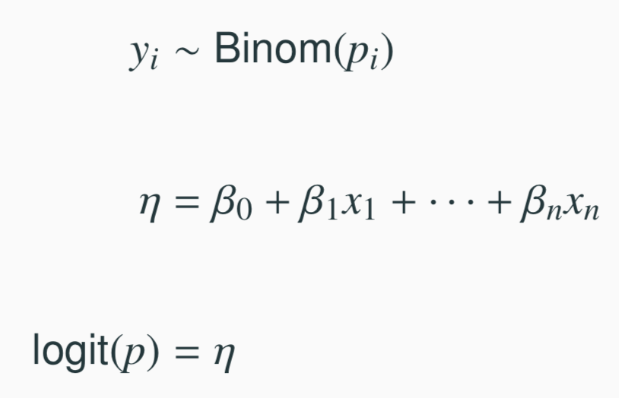
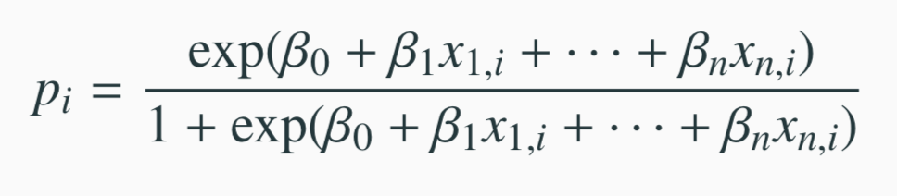
The logistic regression model
The three GLM criteria give us:
From which we arrive at,
27

Slide 18
Example - Donner Party - Model
In R we fit a GLM in the same was as a linear model except using glm instead of lm and we must also specify the type of GLM to fit using the family argument.
summary(glm(Status ~ Age, data=donner, family=binomial))
## Call:
## glm(formula = Status ̃ Age, family = binomial, data = donner)
##
## Coefficients:
## Estimate Std. Error z value Pr(>|z|)
## (Intercept) 1.81852 0.99937 1.820 0.0688 .
## Age -0.06647 0.03222 -2.063 0.0391 *
##
## Null deviance: 61.827 on 44 degrees of freedom
## Residual deviance: 56.291 on 43 degrees of freedom
## AIC: 60.291
27

Slide 19
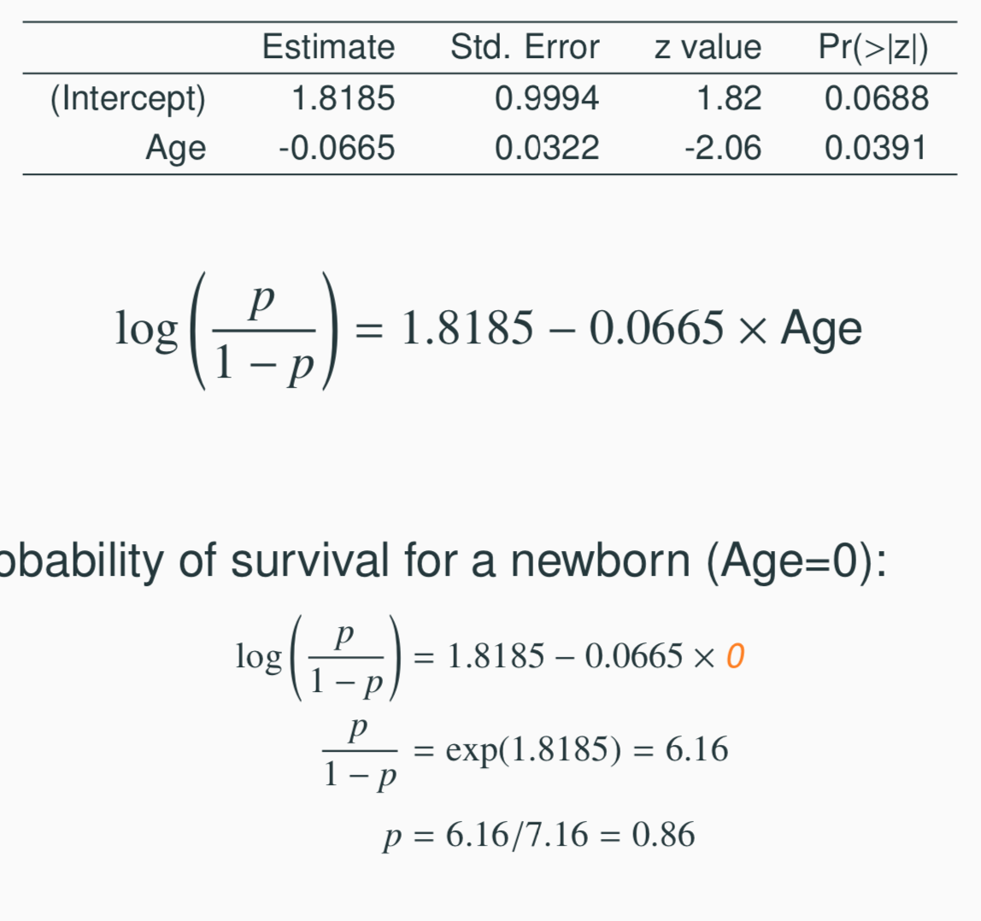
Example - Donner Party - Prediction
Model:
Odds / Probability of survival for a newborn (Age=0):
27

Slide 20
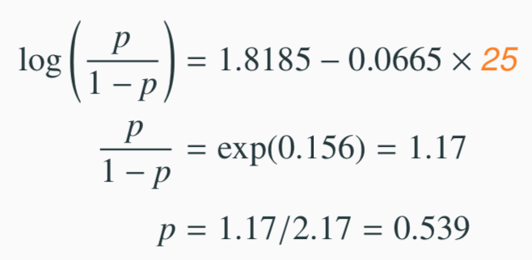
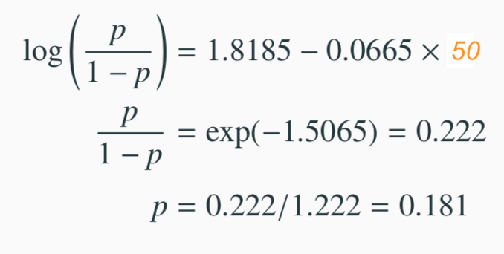
Example - Donner Party - Prediction
Odds / Probability of survival for a 25 year old:
Odds / Probability of survival for a 50 year old:
27

Slide 21
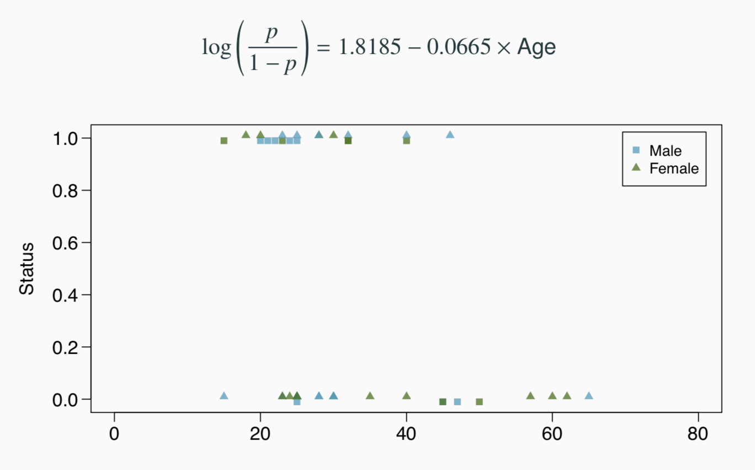
Example - Donner Party - Prediction (cont.)
27

Slide 22
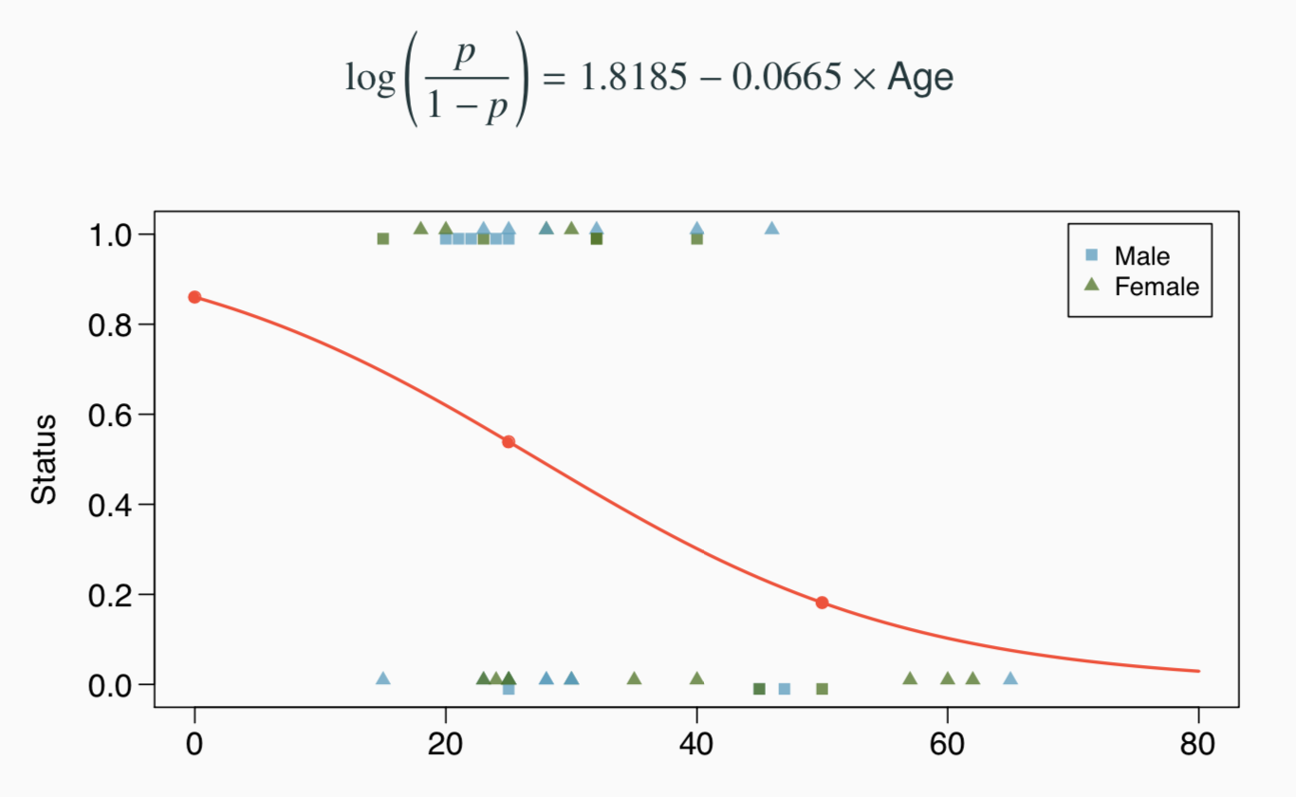
Example - Donner Party - Prediction (cont.)
27

Slide 23
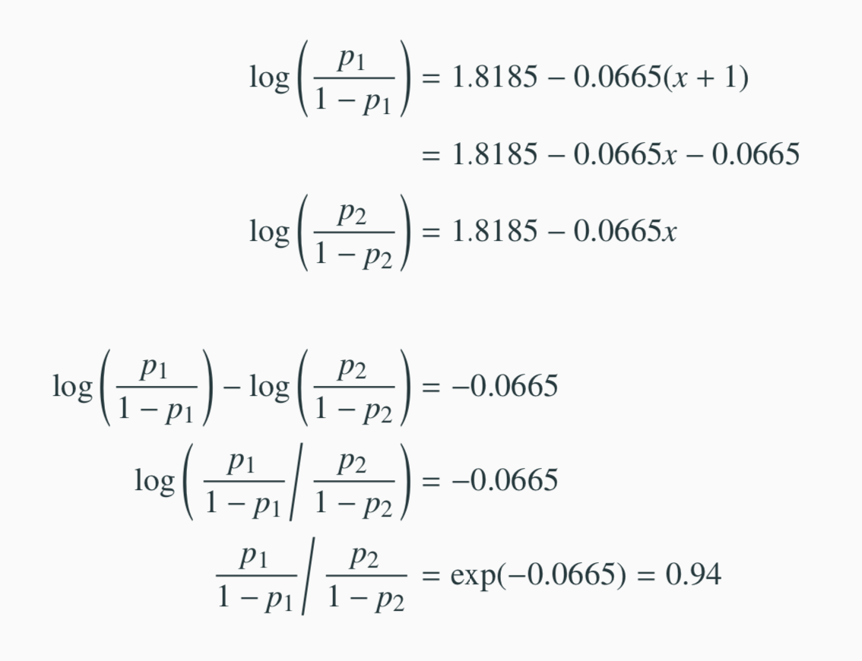
Example - Donner Party - Interpretation
27

Slide 24
Example - Donner Party - Age and Gender
summary(glm(Status ̃ Age + Sex, data=donner, family=binomial))
## Call:
## glm(formula = Status ̃ Age + Sex, family = binomial, data = donner)
##
## Coefficients:
## Estimate Std. Error z value Pr(>|z|)
## (Intercept) 1.63312 1.11018 1.471 0.1413
## Age -0.07820 0.03728 -2.097 0.0359 *
## SexFemale 1.59729 0.75547 2.114 0.0345 *
## ---
##
## (Dispersion parameter for binomial family taken to be 1)
##
## Null deviance: 61.827 on 44 degrees of freedom
## Residual deviance: 51.256 on 42 degrees of freedom
## AIC: 57.256
##
## Number of Fisher Scoring iterations: 4
27

Slide 25
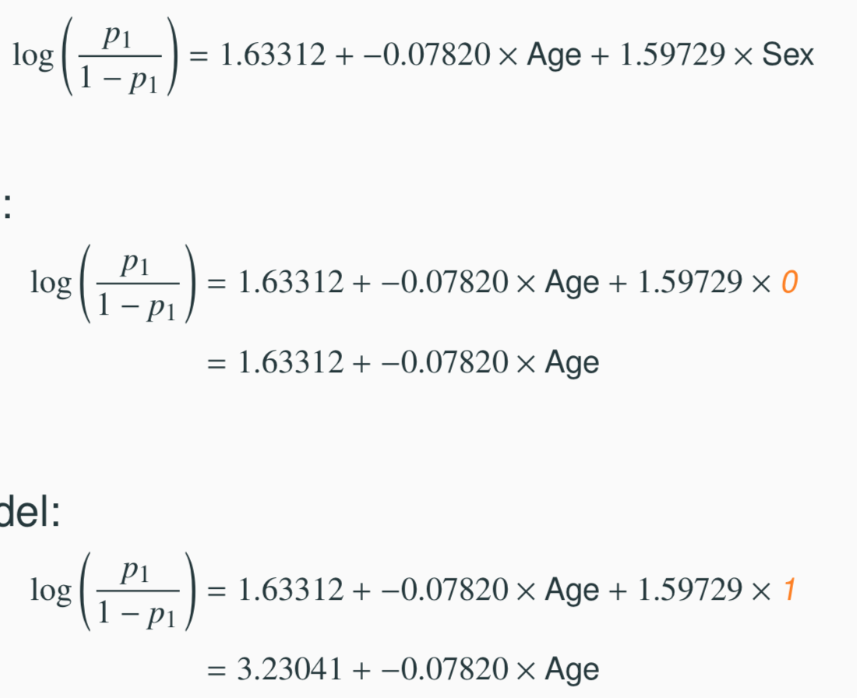
Example - Donner Party - Gender Models
Just like MLR we can plug in gender to arrive at two status vs age models for men and women respectively.
General model:
Male model:
Female model:
27

Slide 26
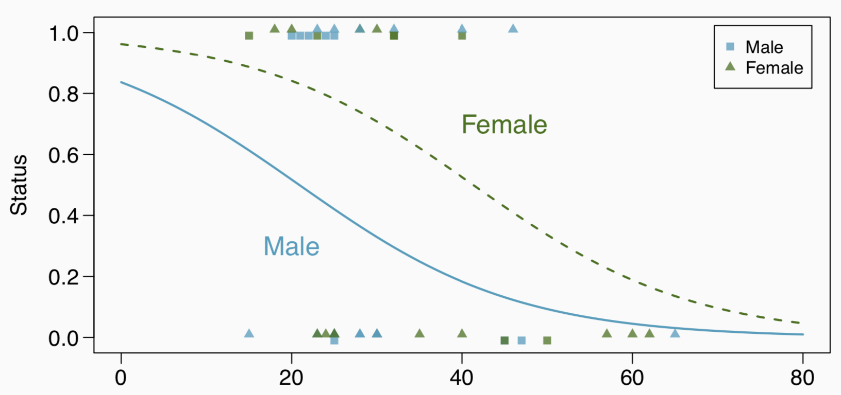
Example - Donner Party - Gender Models (cont.)
27

Slide 27
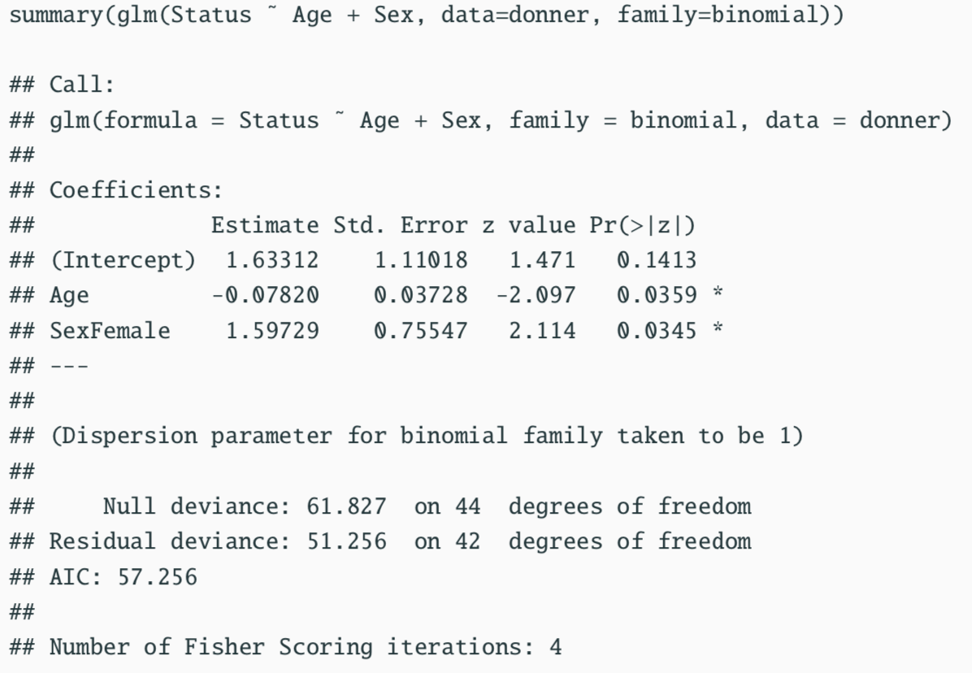
Hypothesis test for the whole model
27

Slide 28
Hypothesis test for the whole model
Note: The model output does not include any F-statistic, as a general rule there are not single model hypothesis tests for GLM models.
27

Slide 29
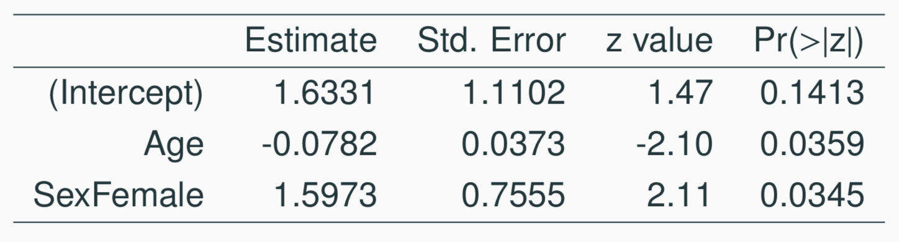
Hypothesis tests for a coefficient
We are however still able to perform inference on individual coefficients, the basic setup is exactly the same as what we’ve seen before except we use a Z-test.
Note: The only tricky bit, which is way beyond the scope of this course, is how the standard error is calculated.
27

Slide 30
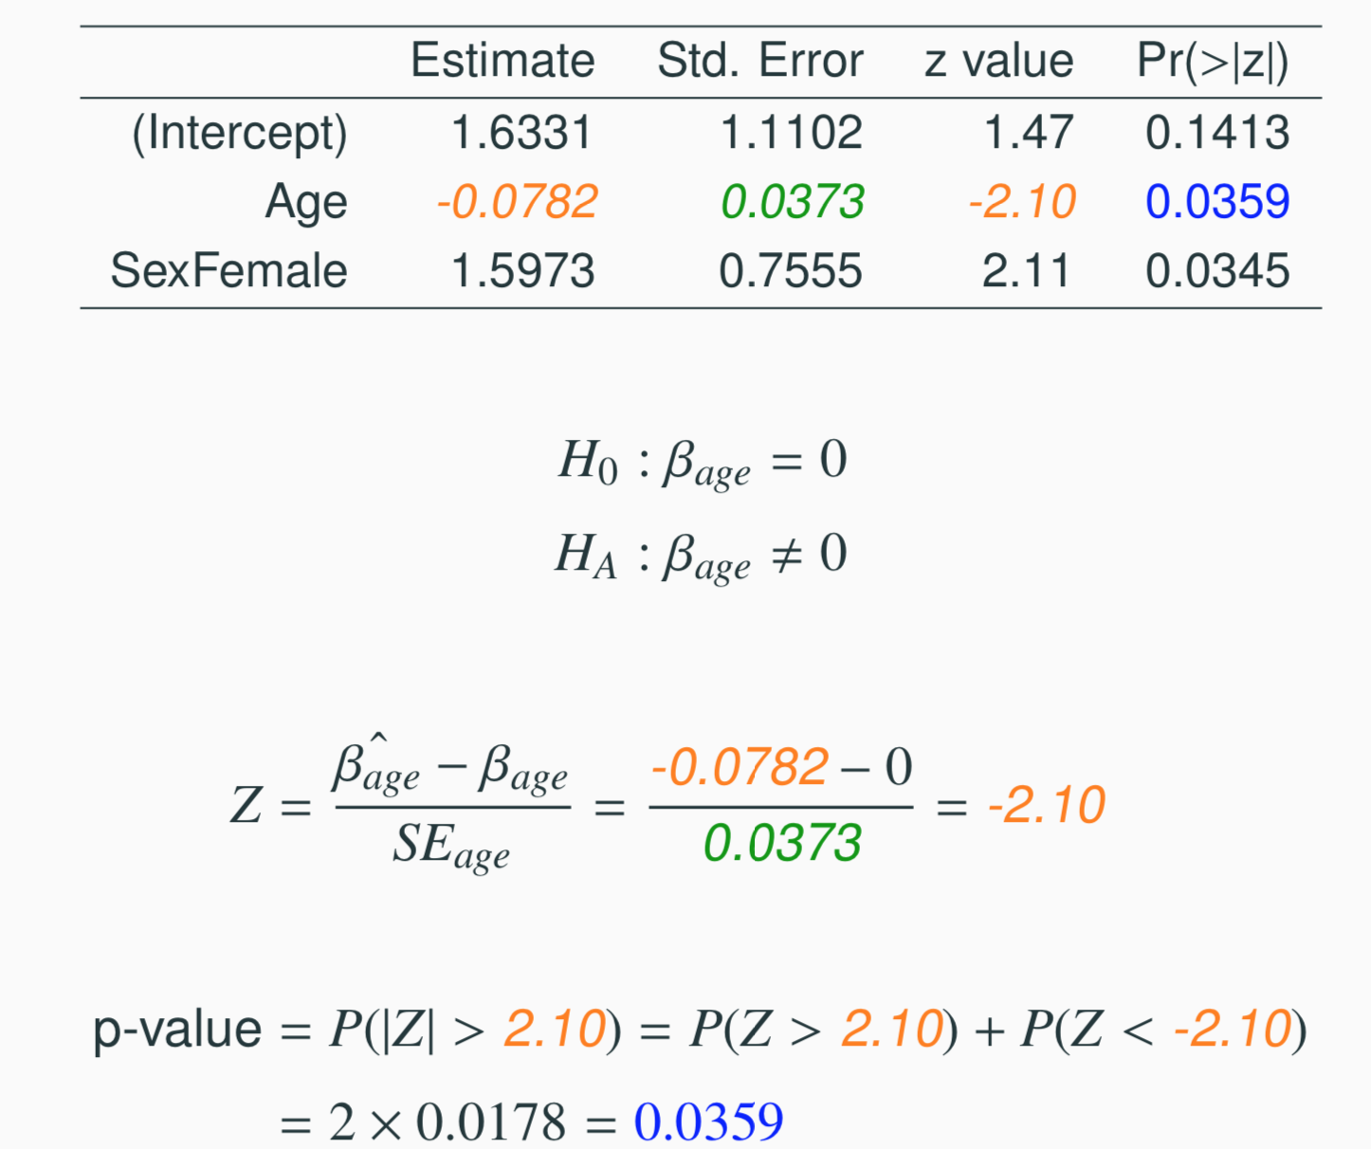
Testing for the slope of Age
27

Slide 31
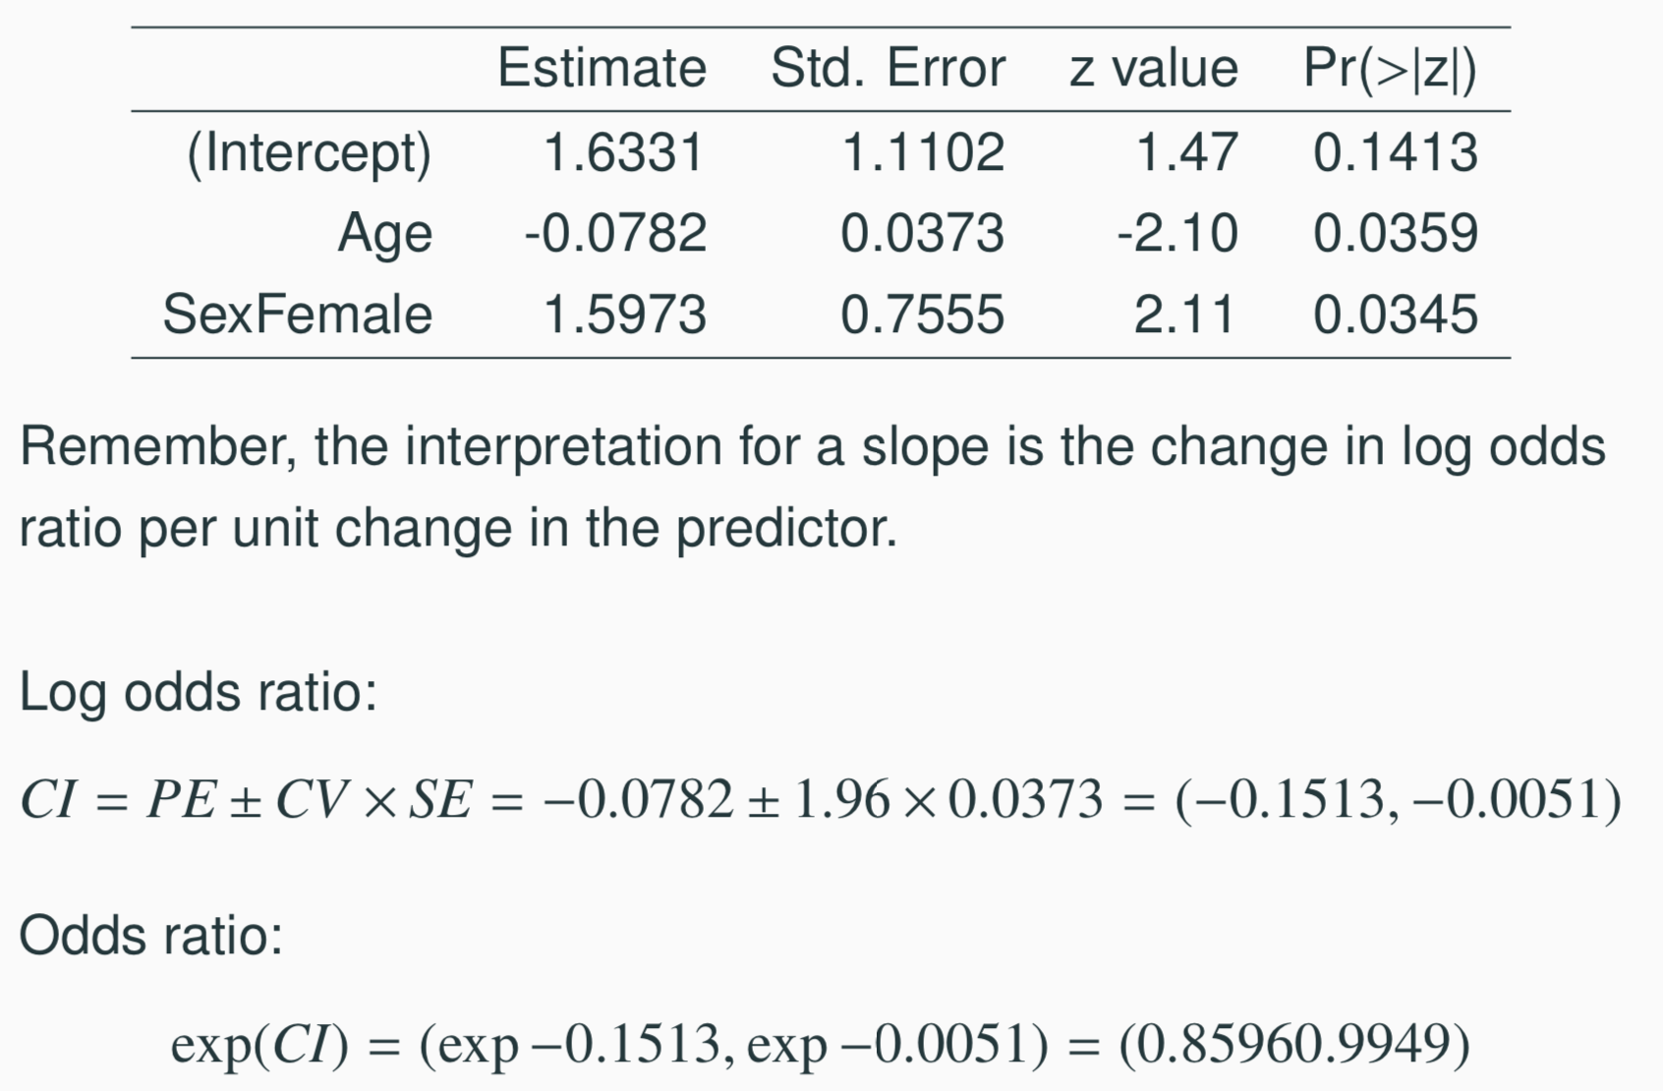
Confidence interval for age slope coefficient
Remember, the interpretation for a slope is the change in log odds ratio per unit change in the predictor.
Log odds ratio:
Odds ratio:
27

Slide 32
Example - Birdkeeping and Lung Cancer
A 1972 - 1981 health survey in The Hague, Netherlands, discovered an association between keeping pet birds and increased risk of lung cancer. To investigate birdkeeping as a risk factor, researchers conducted a case-control study of patients in 1985 at four hospitals in The Hague (population 450,000). They identified 49 cases of lung cancer among the patients who were registered with a general practice, who were age 65 or younger and who had resided in the city since 1965. They also selected 98 controls from a population of residents having the same general age structure.
From Ramsey, F.L. and Schafer, D.W. (2002). The Statistical Sleuth: A Course in Methods of Data Analysis (2nd ed)

Slide 33
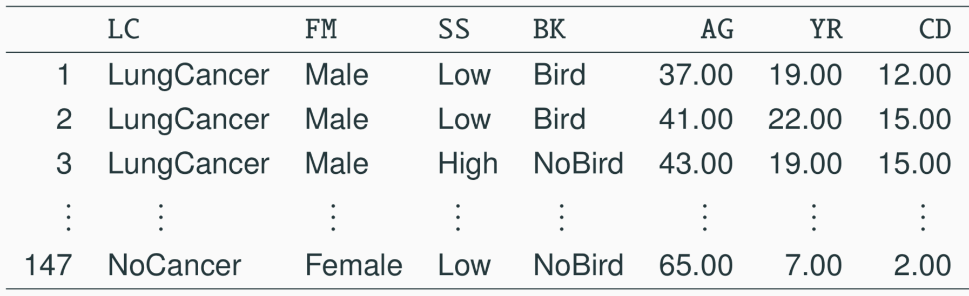
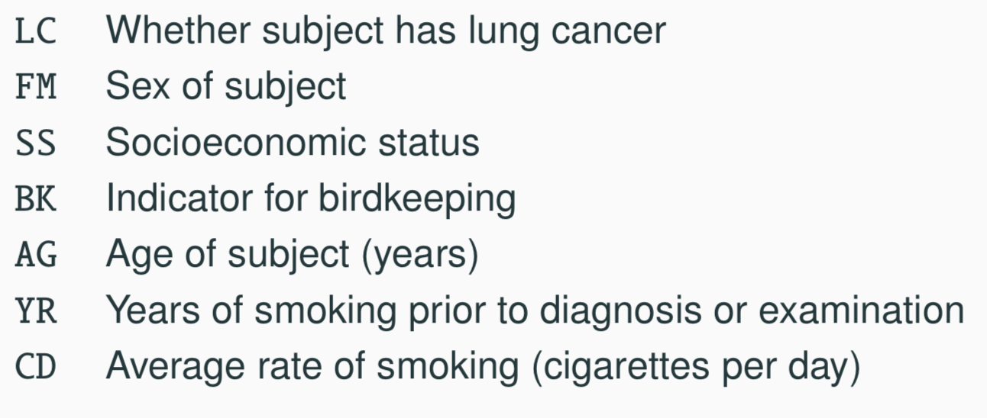
Example - Birdkeeping and Lung Cancer - Data
27

Slide 34
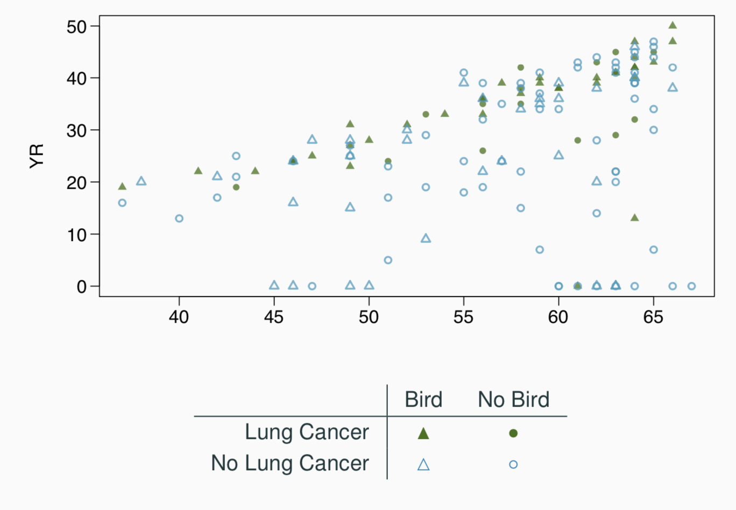
Example - Birdkeeping and Lung Cancer - EDA
27

Slide 35
Example - Birdkeeping and Lung Cancer - Model
summary(glm(LC ~ FM + SS + BK + AG + YR + CD, data=bird, family=binomial))
## Call:
## glm(formula = LC ̃ FM + SS + BK + AG + YR + CD, family = binomial,
## data = bird)
##
## Coefficients:
## Estimate Std. Error z value Pr(>|z|)
## (Intercept) -1.93736 1.80425 -1.074 0.282924
## FMFemale 0.56127 0.53116 1.057 0.290653
## SSHigh 0.10545 0.46885 0.225 0.822050
## BKBird 1.36259 0.41128 3.313 0.000923 ***
## AG -0.03976 0.03548 -1.120 0.262503
## YR 0.07287 0.02649 2.751 0.005940 **
## CD 0.02602 0.02552 1.019 0.308055
##
## (Dispersion parameter for binomial family taken to be 1)
##
## Null deviance: 187.14 on 146 degrees of freedom
## Residual deviance: 154.20 on 140 degrees of freedom
## AIC: 168.2
27

Slide 36
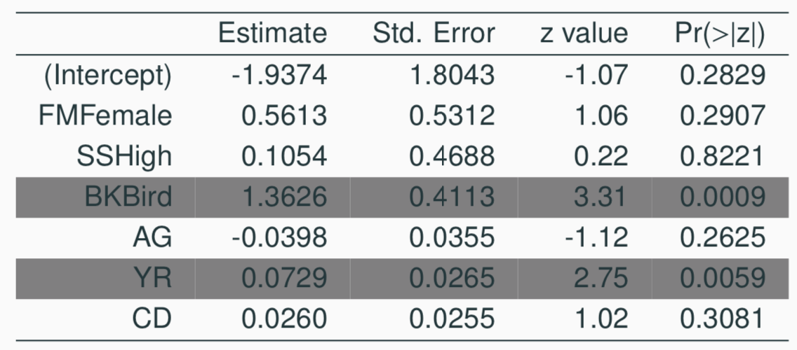
Example - Birdkeeping and Lung Cancer - Interpretation
Keeping all other predictors constant then,
The odds ratio of getting lung cancer for bird keepers vs non-bird keepers is exp(1.3626) = 3.91.
The odds ratio of getting lung cancer for an additional year of smoking is exp(0.0729) = 1.08.
27

Slide 37
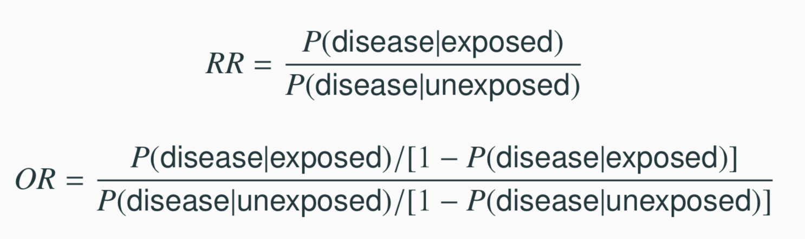
What do the numbers not mean ...
The most common mistake made when interpreting logistic regression is to treat an odds ratio as a ratio of probabilities.
Bird keepers are not 4x more likely to develop lung cancer than non-bird keepers.
This is the difference between relative risk and an odds ratio.
27

Slide 38
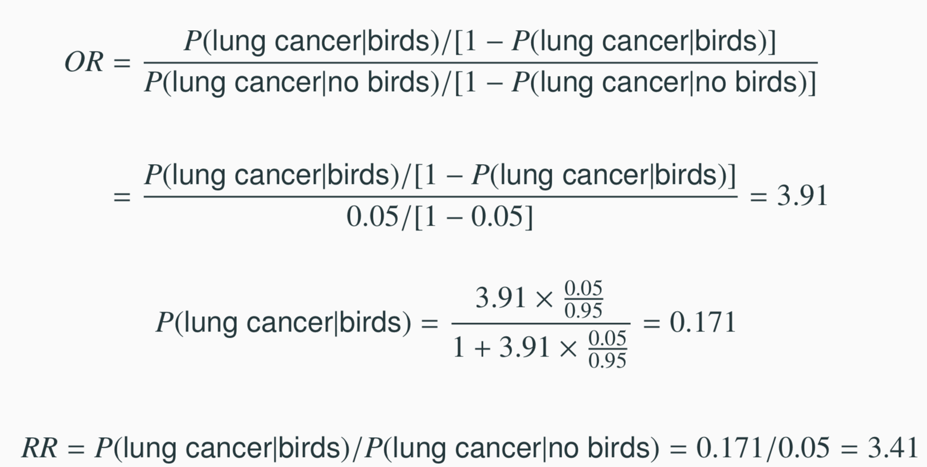
Back to the birds
What is probability of lung cancer in a bird keeper if we knew that P(lung cancer|no birds) = 0.05?
27

Slide 39
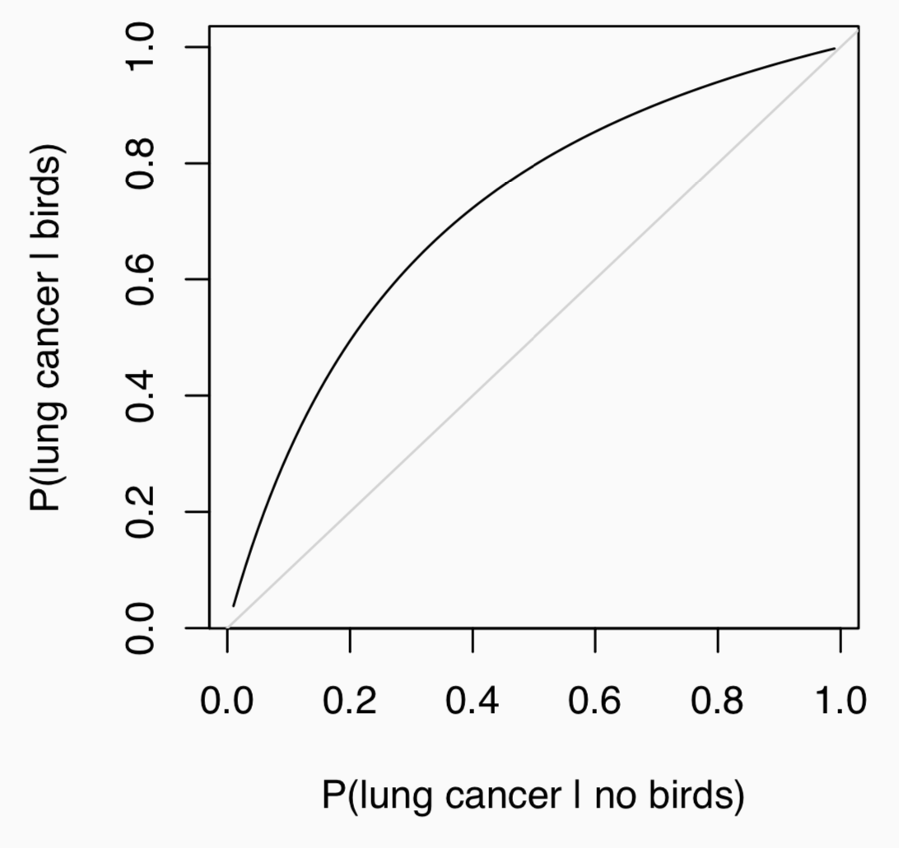
Bird OR Curve
27

Slide 40
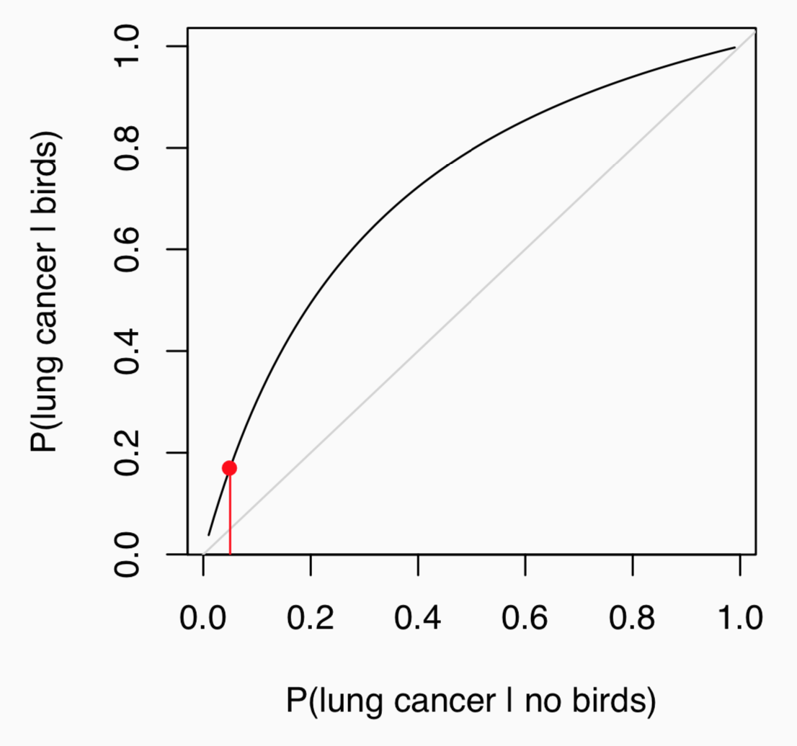
Bird OR Curve
27

Slide 41
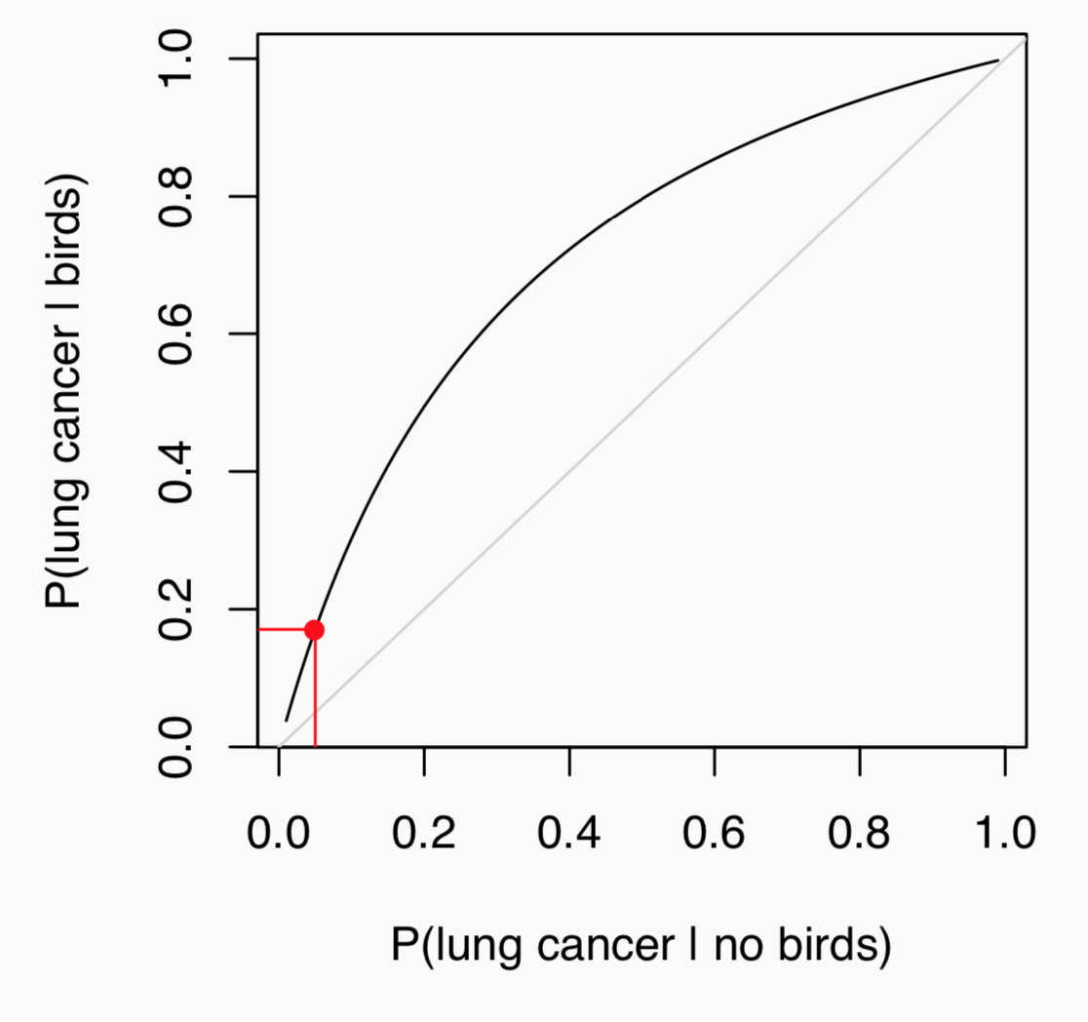
Bird OR Curve
27

Slide 42
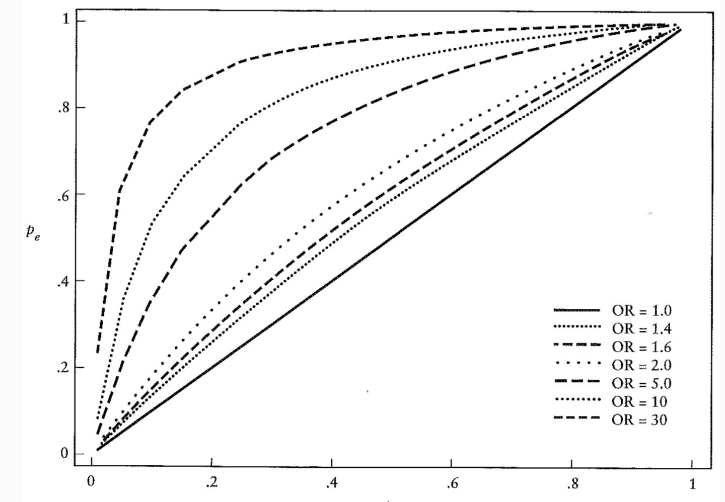
OR Curves
27

Slide 43
(An old) Example - House
If you’ve ever watched the TV show House on Fox, you know that Dr. House regularly states, “It’s never lupus.”
Lupus is a medical phenomenon where antibodies that are supposed to attack foreign cells to prevent infections instead see plasma proteins as foreign bodies, leading to a high risk of blood clotting. It is believed that 2% of the population suffer from this disease.
The test for lupus is very accurate if the person actually has lupus, however is very inaccurate if the person does not. More specifically, the test is 98% accurate if a person actually has the disease. The test is 74% accurate if a person does not have the disease.
Is Dr. House correct even if someone tests positive for Lupus?
89

Slide 44
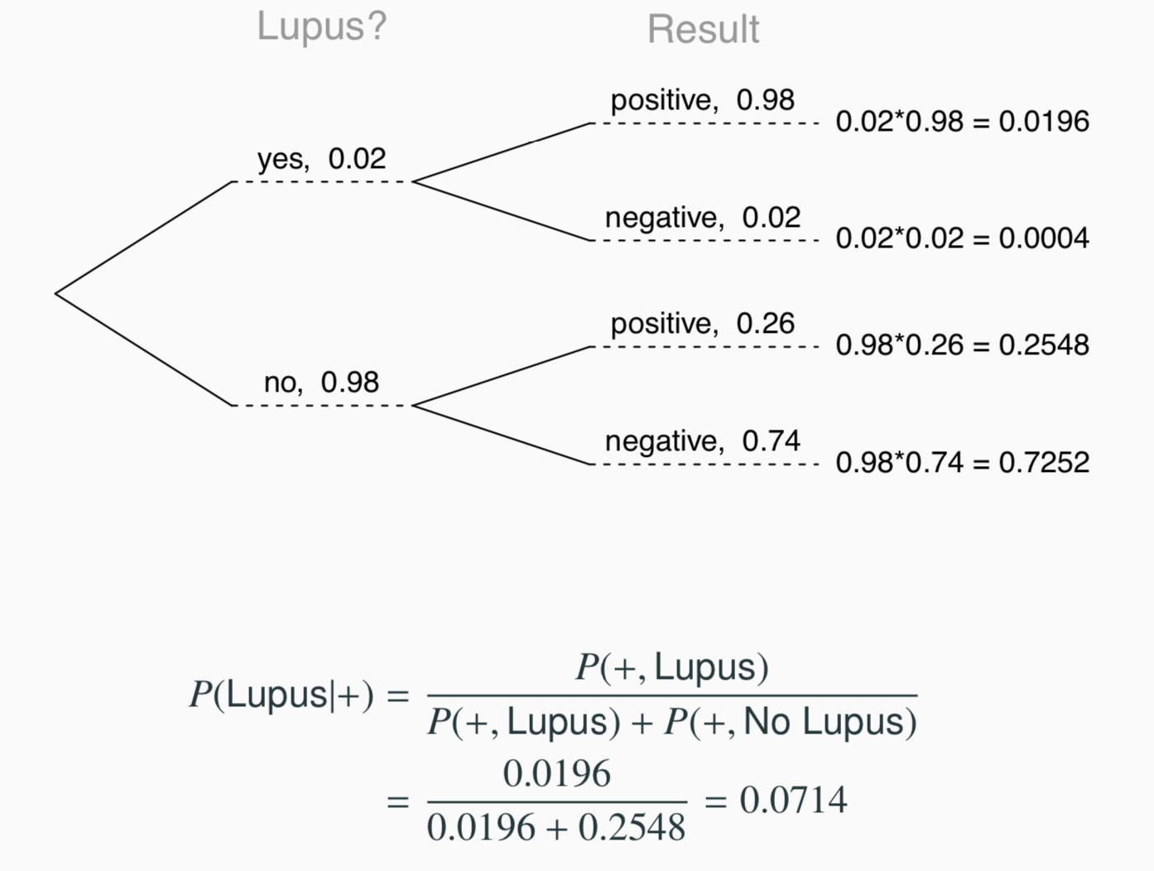
(An old) Example - House
27

Slide 45
Testing for lupus
It turns out that testing for Lupus is actually quite complicated, a diagnosis usually relies on the outcome of multiple tests, often including: a complete blood count, an erythrocyte sedimentation rate, a kidney and liver assessment, a urinalysis, and or an antinuclear antibody (ANA) test.
It is important to think about what is involved in each of these tests (e.g. deciding if complete blood count is high or low) and how each of the individual tests and related decisions plays a role in the overall decision of diagnosing a patient with lupus.
27

Slide 46
Testing for lupus
At some level we can view a diagnosis as a binary decision (lupus or no lupus) that involves the complex integration of various explanatory variables.
The example does not give us any information about how a diagnosis is made, but what it does give us is just as important - the sensitivity and the specificity of the test. These values are critical for our understanding of what a positive or negative test result actually means.
27

Slide 47
Sensitivity and Specificity
Sensitivity - measures a tests ability to identify positive results.
P(Test + | Conditon +) = P(+|lupus) = 0.98
Specificity - measures a tests ability to identify negative results.
P(Test − | Condition −) = P(−|no lupus) = 0.74
27

Slide 48
Sensitivity and Specificity
Sensitivity - measures a tests ability to identify positive results.
P(Test + | Conditon +) = P(+|lupus) = 0.98
Specificity - measures a tests ability to identify negative results.
P(Test − | Condition −) = P(−|no lupus) = 0.74
It is illustrative to think about the extreme cases - what is the sensitivity and specificity of a test that always returns a positive result? What about a test that always returns a negative result?
27

Slide 49
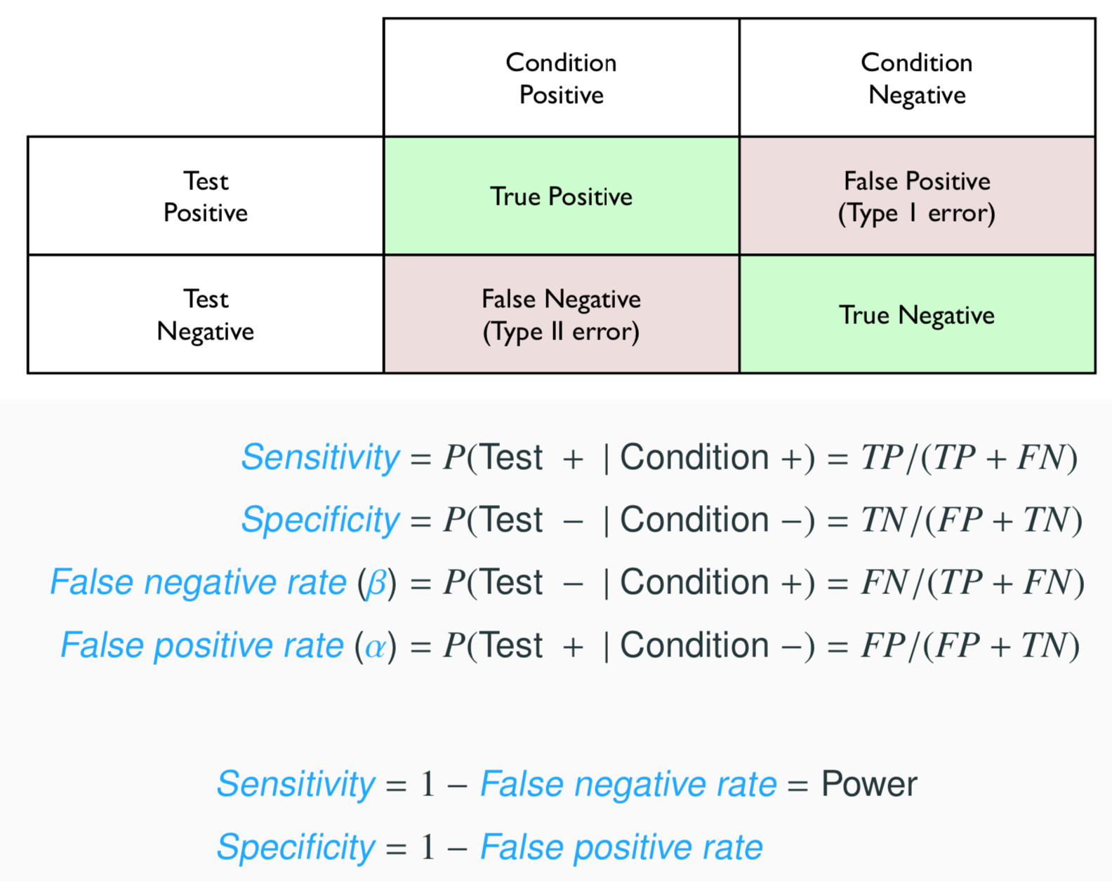
Sensitivity and Specificity (cont.)
27

Slide 50
So what?
Clearly it is important to know the Sensitivity and Specificity of test (and or the false positive and false negative rates). Along with the incidence of the disease (e.g. P(lupus)) these values are necessary to calculate important quantities like P(lupus|+).
Additionally, our brief foray into power analysis before the first midterm should also give you an idea about the trade offs that are inherent in minimizing false positive and false negative rates (increasing power required either increasing α or n).
How should we use this information when we are trying to come up with a decision?
27

Slide 51
Back to Spam
In lab this week, we examined a data set of emails where we were interesting in identifying the spam messages. We examined different logistic regression models to evaluate how different predictors influenced the probability of a message being spam.
These models can also be used to assign probabilities to incoming messages (this is equivalent to prediction in the case of SLR / MLR). However, if we were designing a spam filter this would only be half of the battle, we would also need to use these probabilities to make a decision about which emails get flagged as spam.
While not the only possible solution, we will consider a simple approach where we choose a threshold probability and any email that exceeds that probability is flagged as spam.
27

Slide 52
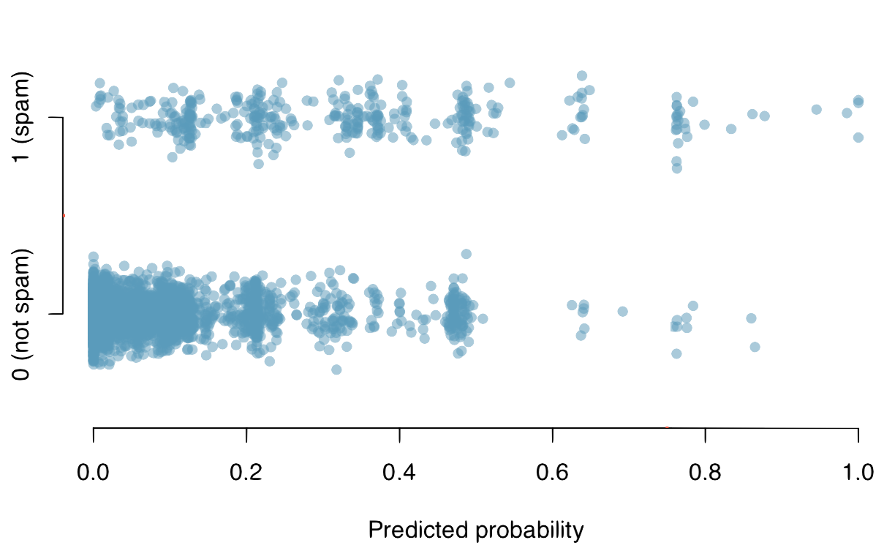
Picking a threshold
27

Slide 53
Picking a threshold
Lets see what happens if we pick our threshold to be 0.75.
27

Slide 54

Picking a threshold
Lets see what happens if we pick our threshold to be 0.75.
27

Slide 55
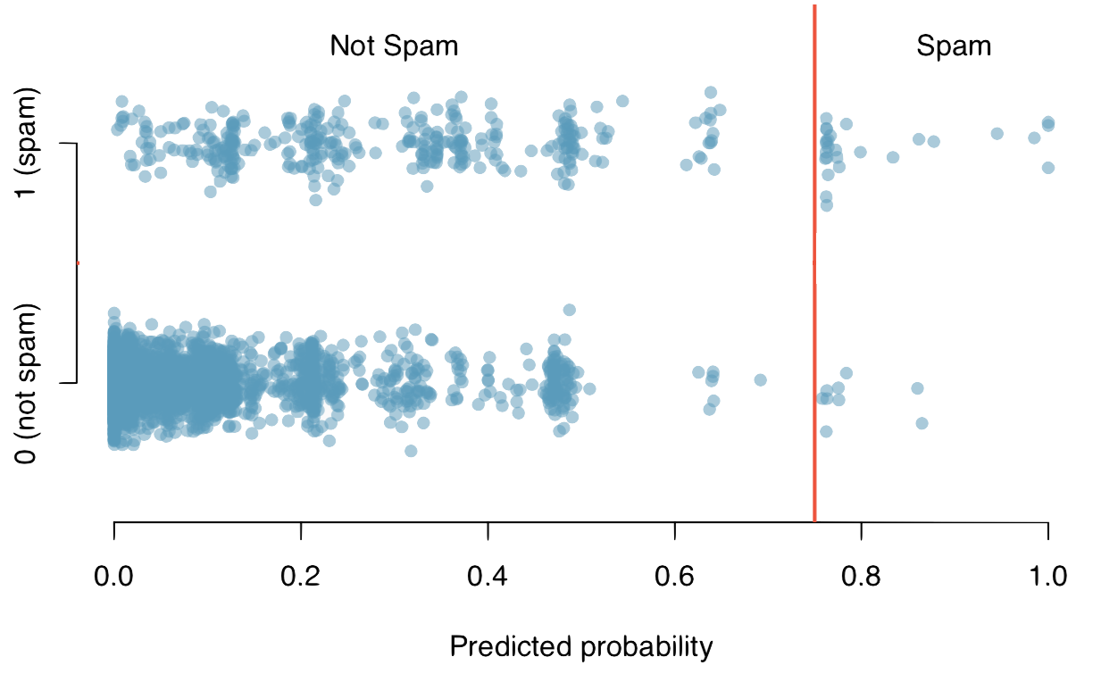
Picking a threshold
Lets see what happens if we pick our threshold to be 0.75.
27

Slide 56
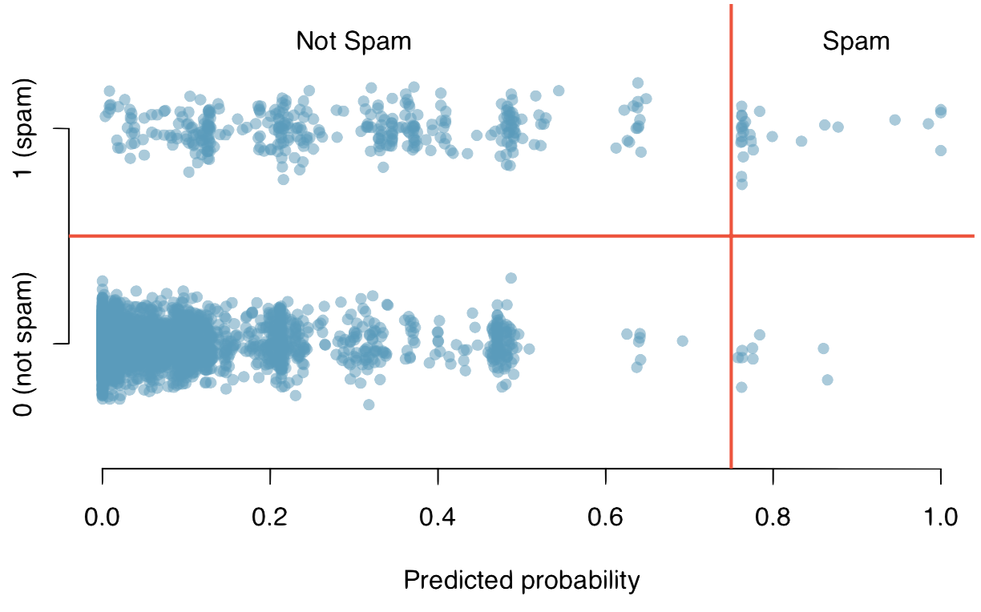
Picking a threshold
Lets see what happens if we pick our threshold to be 0.75.
27

Slide 57
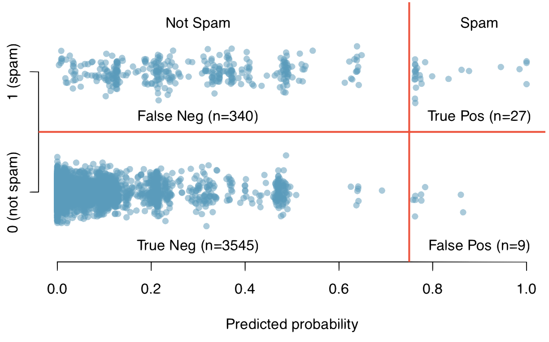
Picking a threshold
Lets see what happens if we pick our threshold to be 0.75.
27

Slide 58
Consequences of picking a threshold
For our data set picking a threshold of 0.75 gives us the following results:
FN = 340 TP = 27
TN = 3545 FP = 9
27

Slide 59
Consequences of picking a threshold
For our data set picking a threshold of 0.75 gives us the following results:
FN = 340 TP = 27
TN = 3545 FP = 9
What are the sensitivity and specificity for this particular decision rule?
27

Slide 60
Consequences of picking a threshold
For our data set picking a threshold of 0.75 gives us the following results:
FN = 340 TP = 27
TN = 3545 FP = 9
What are the sensitivity and specificity for this particular decision rule?
Sensitivity = TP/(TP + FN) = 27/(27 + 340) = 0.073
Specificity = TN/(FP + TN) = 3545/(9 + 3545) = 0.997
27

Slide 61
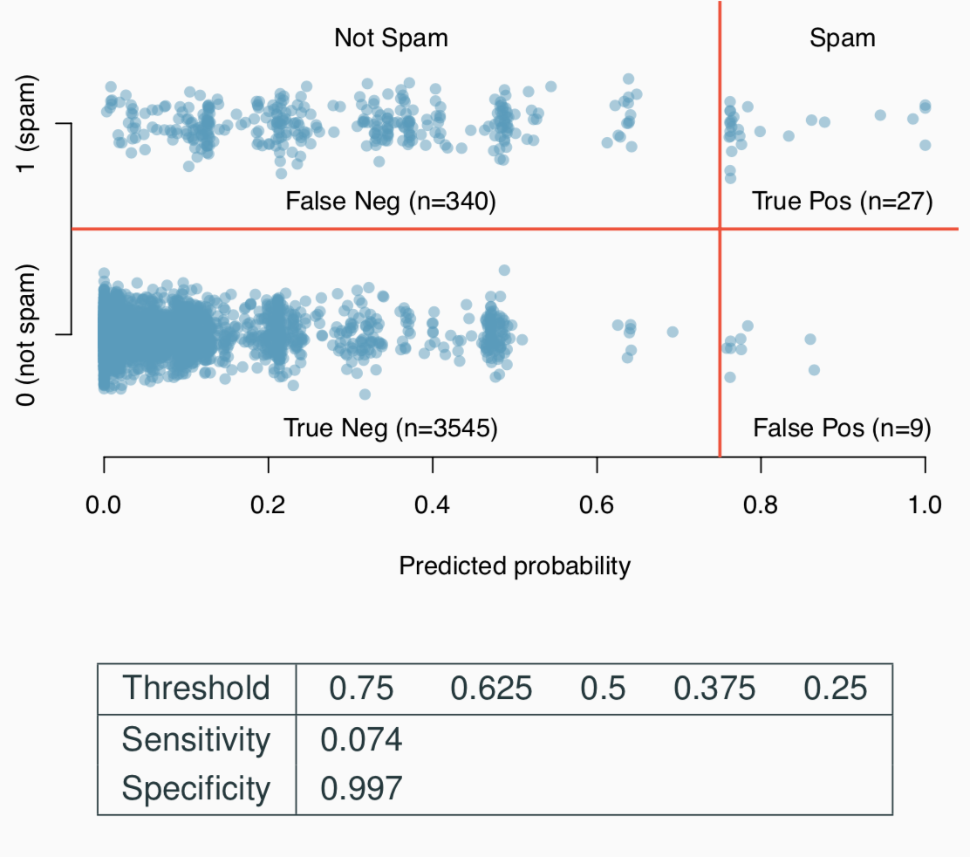
Trying other thresholds
27

Slide 62
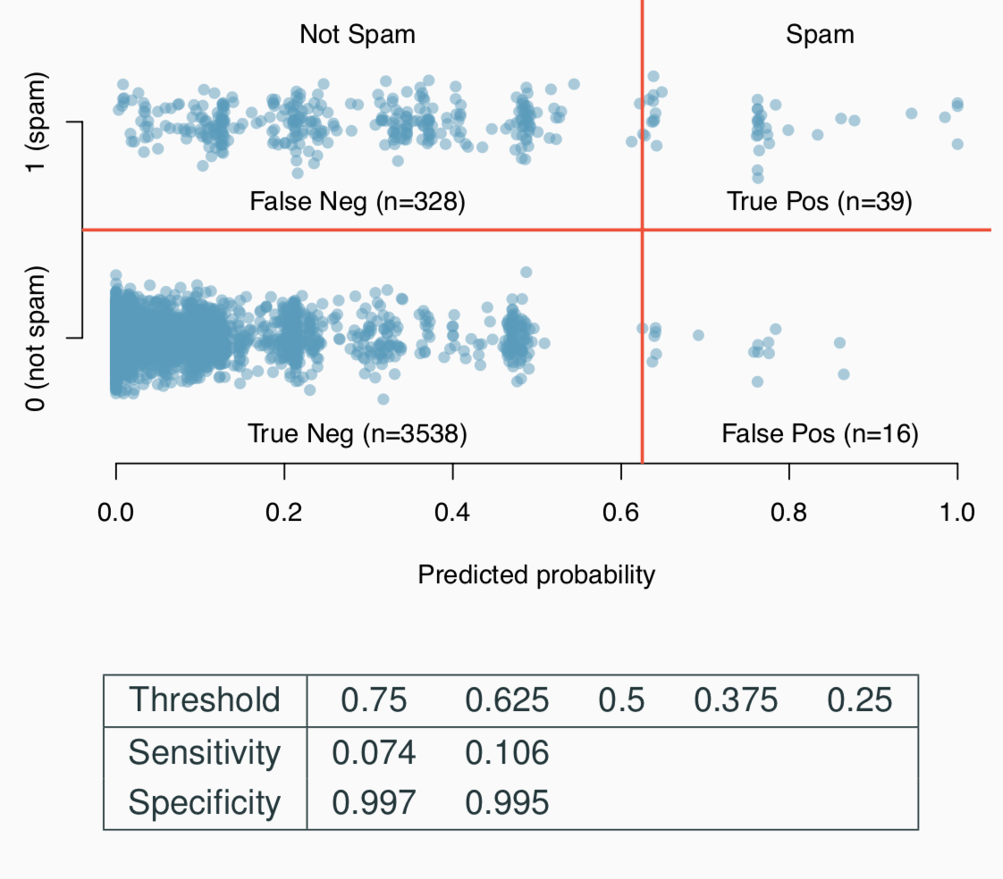
Trying other thresholds
27

Slide 63
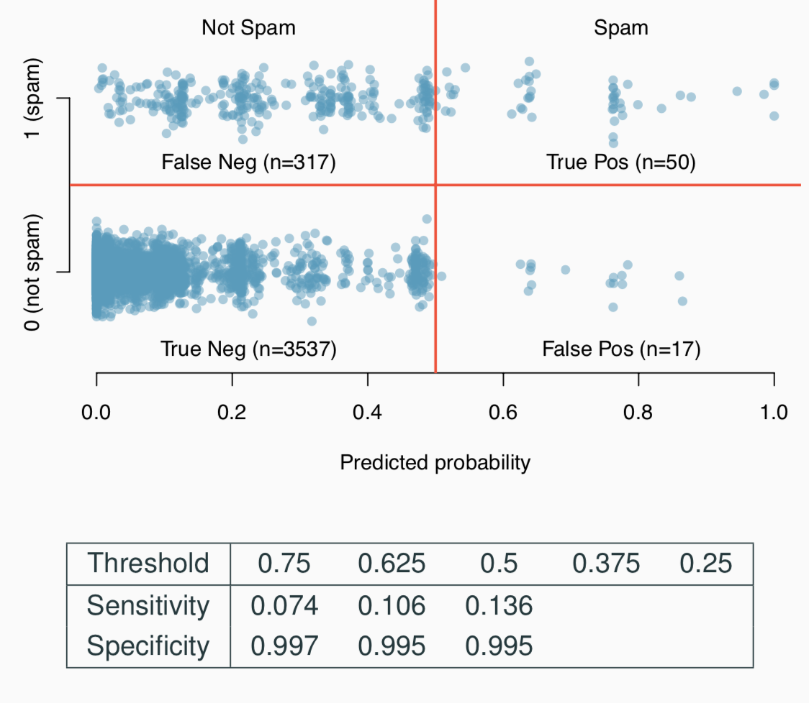
Trying other thresholds
27

Slide 64
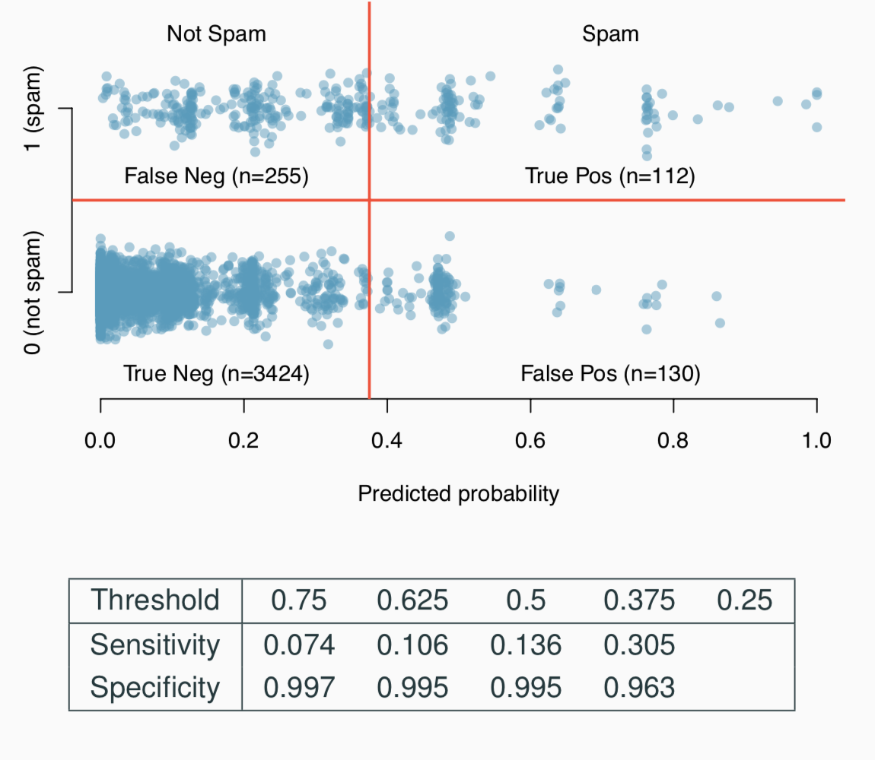
Trying other thresholds
27

Slide 65
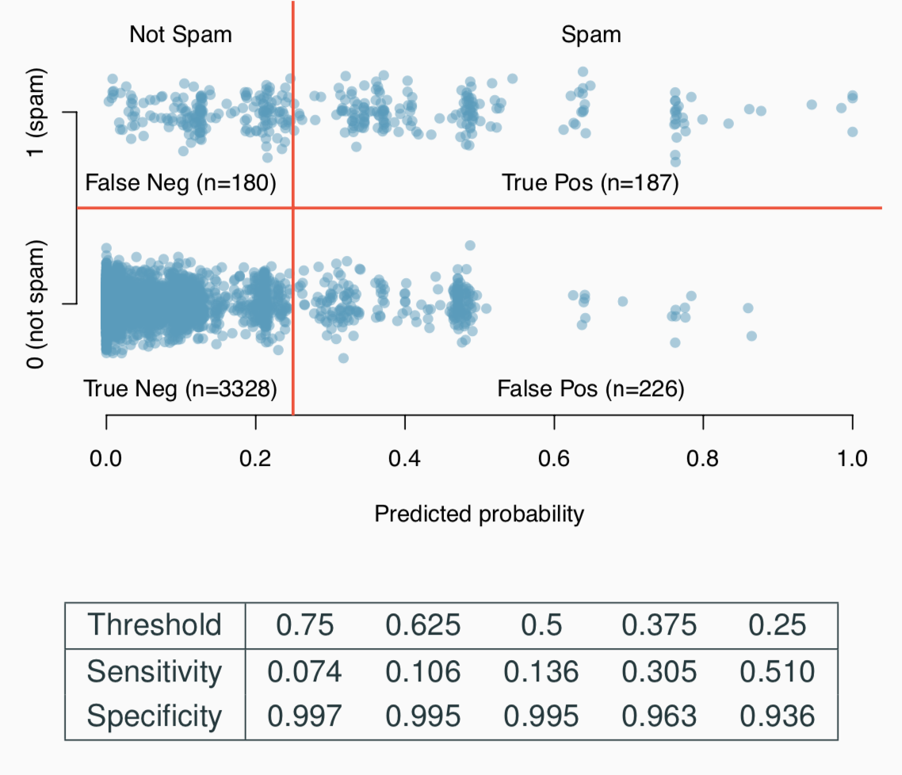
Trying other thresholds
27

Slide 66
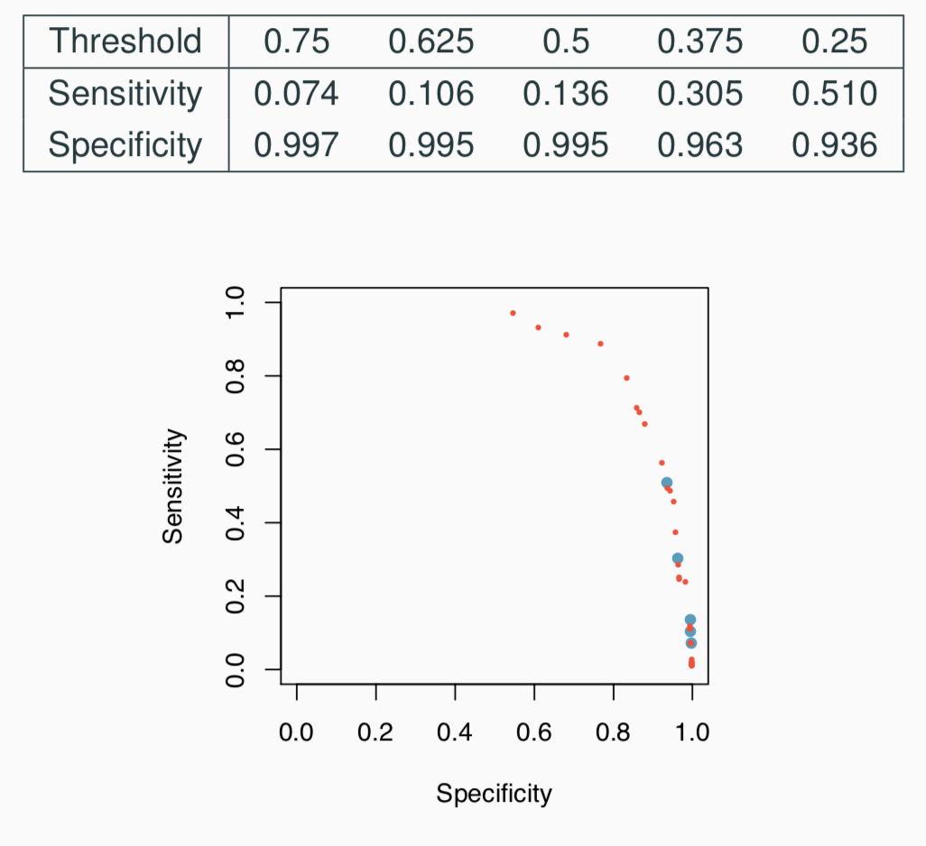
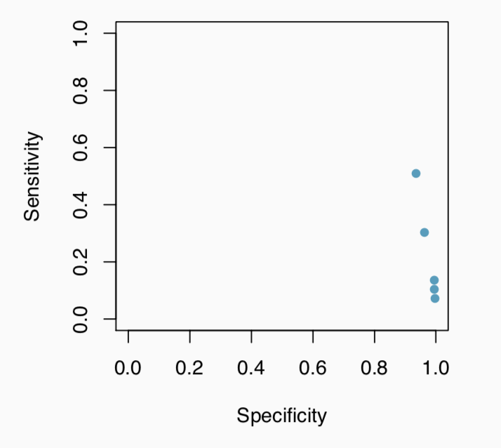
Relationship between Sensitivity and Specificity
27

Slide 67
Relationship between Sensitivity and Specificity
27

Slide 68
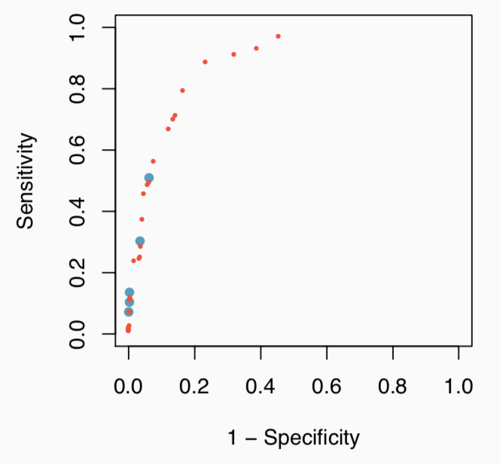
Relationship between Sensitivity and Specificity
27

Slide 69
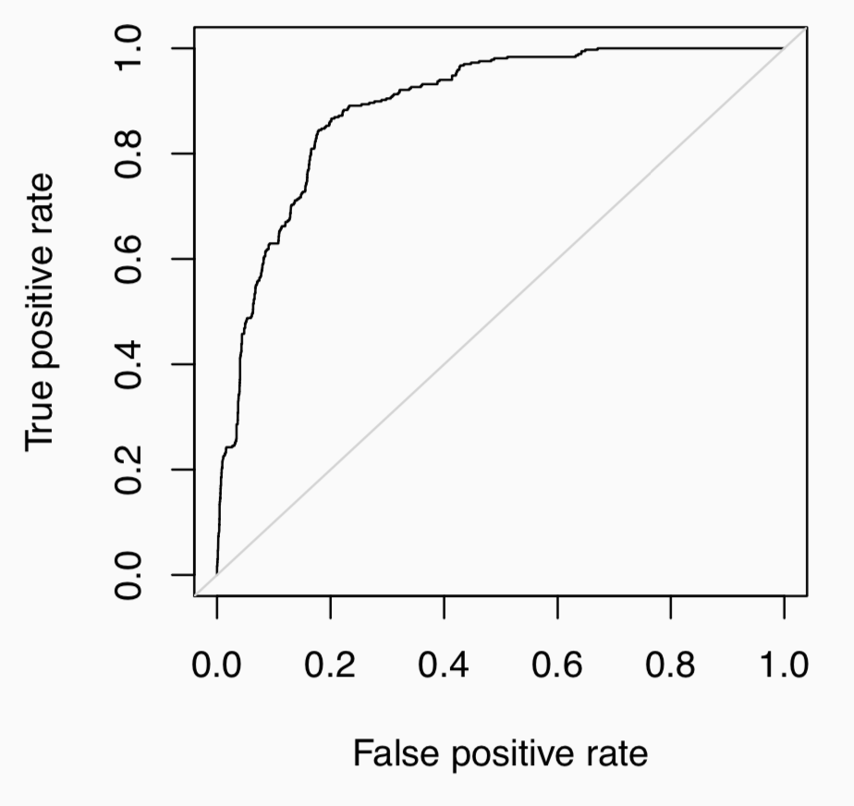
Receiver operating characteristic (ROC) curve
27

Slide 70
Receiver operating characteristic (ROC) curve (cont.)
Why do we care about ROC curves?
Shows the trade off in sensitivity and specificity for all possible thresholds.
Straight forward to compare performance vs. chance.
Can use the area under the curve (AUC) as an assessment of the predictive ability of a model.
27

Slide 71
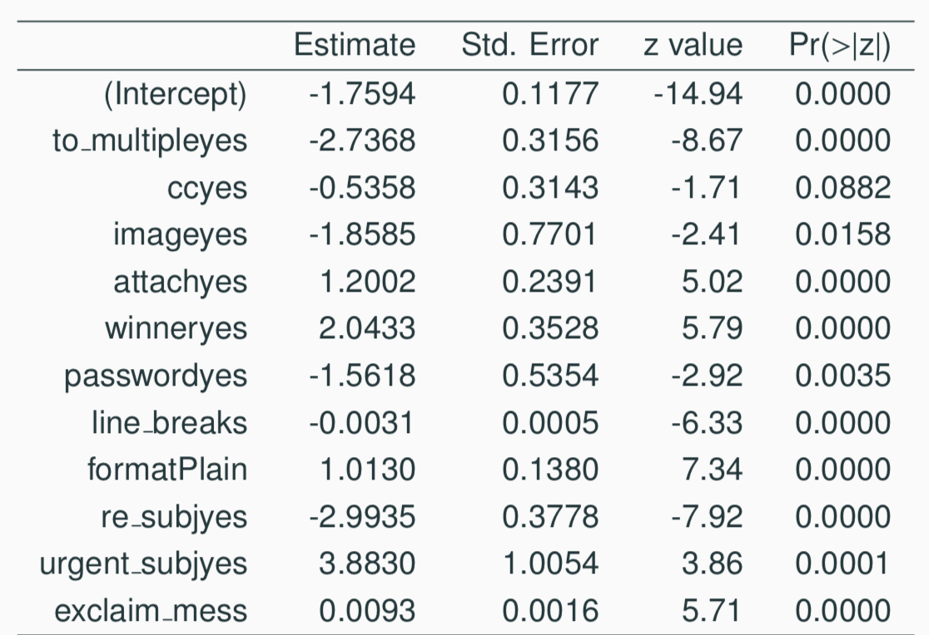
Refining the Spam model
g_refined = glm(spam ~ to_multiple+cc+image+attach+winner
+password+line_breaks+format+re_subj
+urgent_subj+exclaim_mess,
data=email, family=binomial)
summary(g_refined)
27

Slide 72
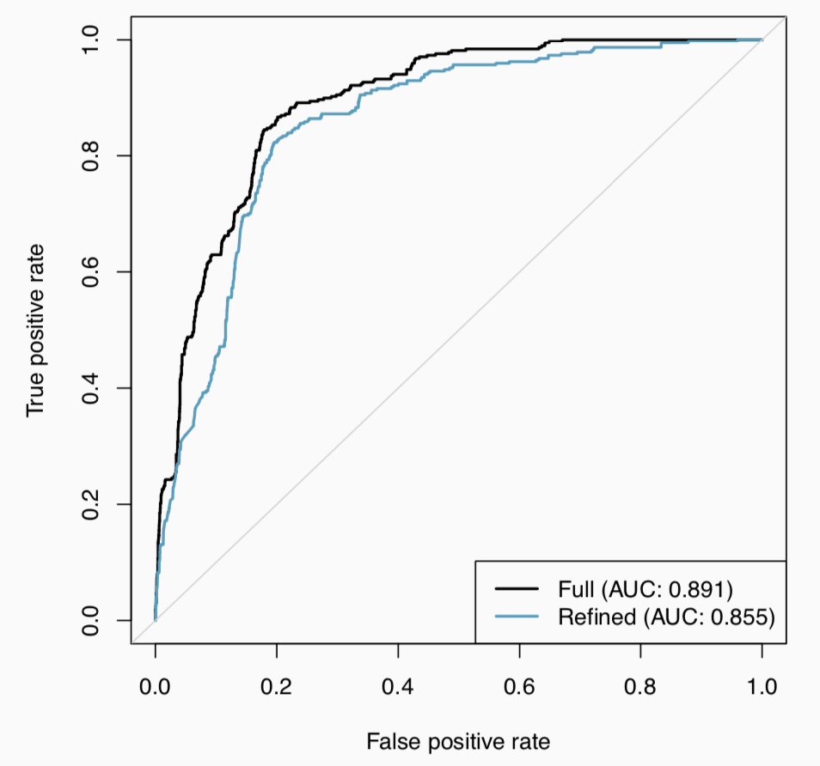
Comparing models
27

Slide 73
Utility Functions
There are many other reasonable quantitative approaches we can use to decide on what is the “best” threshold.
If you’ve taken an economics course you have probably heard of the idea of utility functions, we can assign costs and benefits to each of the possible outcomes and use those to calculate a utility for each circumstance.
27

Slide 74

Utility function for our spam filter
To write down a utility function for a spam filter we need to consider the costs / benefits of each out.
27

Slide 75

Utility function for our spam filter
To write down a utility function for a spam filter we need to consider the costs / benefits of each out.
27

Slide 76

Utility function for our spam filter
To write down a utility function for a spam filter we need to consider the costs / benefits of each out.
27

Slide 77

Utility function for our spam filter
To write down a utility function for a spam filter we need to consider the costs / benefits of each out.
27

Slide 78

Utility function for our spam filter
To write down a utility function for a spam filter we need to consider the costs / benefits of each out.
27

Slide 79
Utility function for our spam filter
To write down a utility function for a spam filter we need to consider the costs / benefits of each out.
27

Slide 80
Utility for the 0.75 threshold
For the email data set picking a threshold of 0.75 gives us the following results:
FN = 340 TP = 27 TN = 3545 FP = 9
U(p) = TP(p) + TN(p) − 50 × FP(p) − 5 × FN(p) = 27 + 3545 − 50 × 9 − 5 × 340 = 1422
Not useful by itself, but allows us to compare with other thresholds.
27

Slide 81

Utility curve
27

Slide 82

Utility curve (zoom)
27

Slide 83

Utility curve (zoom)
27

Slide 84

Maximum Utility
27

Slide 85
Find more resources at openintro.org/os, including
Slides
Videos
Statistical Software Labs
Discussion Forums (free support for students and teachers)
Learning Objectives
Teachers only content is also available for Verified Teachers, including
Exercise solutions
Sample exams
Ability to request a free desk copy for a course
Statistics Teachers email group
Questions? Contact us.

